Slide 1
Year 4
HIAS Blended Learning Resource
Geometry
Describe the positions on a 2D-grid as co-ordinates in the first quadrant.
HIAS maths Team
Spring 2021
Final version
© Hampshire County Council

Slide 2
HIAS Blended Learning Resource
These slides are intended to support teachers and pupils with a blended approach to learning, either in-class or online. The tasks are intended to form part of a learning journey and could be the basis of either one lesson or a short sequence of connected lessons.
The 4-step Polya model for problem solving has been used to provide a structure to support reasoning. Teachers may need to use more or fewer steps to support the range of learners in their class.
Teachers should delete, change and add slides to suit the needs of their pupils. Extra slides with personalised prompts and appropriate examples based on previous teaching may be suitable. When changing the slide-deck, teachers should consider:
Their expectations for the use of representations such as bar models, number lines, arrays and diagrams.
Which strategies and methods pupils should use and record when solving problems or identifying solutions. This could include a range of informal jottings and diagrams, the use of tables to record solutions systematically and formal or informal calculation methods.
Teachers may also wish to record a ‘voice over’ to talk pupils through the slides.

Slide 3
HIAS Blended Learning Resource
1945 George Polya published ‘How To Solve It’ 2nd ed., Princeton University Press, 1957, ISBN 0-691-08097-6.

Slide 4
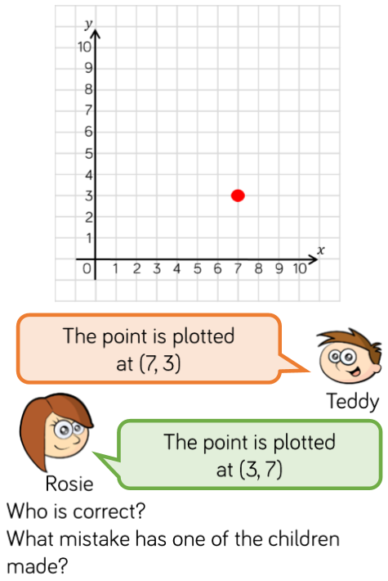
Describing positions on a 2D-grid as co-ordinates in the first quadrant
HIAS Blended Learning Resource

Slide 5
Understand the problem
HIAS Blended Learning Resource
Look carefully at the point plotted on the 2D-grid. How can we describe where the point is positioned using co-ordinates?
Key fact: We can describe the position of points on a 2D-grid by using co-ordinates (pairs of (x,y) co-ordinates.
Key fact: The x-axis is the horizontal axis, the y-axis is the vertical axis.
Key fact: The order in which you write x- and y-coordinates in an ordered pair is very important. The x-coordinate always comes first, followed by the y-coordinate.

Slide 6
Make a Plan
HIAS Blended Learning Resource
Step 1:
Look carefully at the plotted point on the 2D grid
Step 2:
Read along the x-axis (horizontal axis) until you hit the point
Step 3:
Read along the y-axis (vertical axis) until you hit the point
Step 4:
Write the position of the point as a paired
co-ordinate

Slide 7
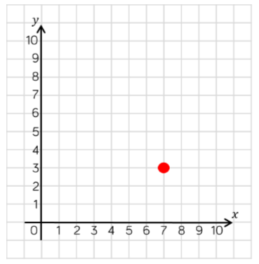
Can you find the plotted point on the 2D grid?
Can you identify the x-axis (horizontal axis)?
Can you identify the y-axis (vertical axis)?
Remember to trace your finger across the 2D-grid to help you

Slide 8
Carry out your plan: show your reasoning
HIAS Blended Learning Resource
Step 1:
Look carefully at the plotted point on the 2D grid
Step 2:
Read along the x-axis (horizontal axis) until you hit the point
Step 3:
Read along the y-axis (vertical axis) until you hit the point
Step 4:
Write the position of the point as a paired co-ordinate
Who is correct – Teddy or Rosie?
What mistake has one of them made?

Slide 9
Step 1: Look carefully at the plotted point on the 2D grid
Step 2: Read along the x-axis (horizontal axis) until you hit the point
The point is 7 along the x-axis
Step 3: Read along the y-axis (vertical axis) until you hit the point
The point is 3 up the y-axis
Step 4: Write the position of the point as a paired
co-ordinate
(7,3)
Teddy is correct as he described the position of the point accurately (7,3). Rosie made a mistake. She read the y-axis before the x-axis (3,7).

Slide 10
Review your solution: does it seem reasonable? Which steps/ parts did you find easy and which harder?
HIAS Blended Learning Resource
How could you check?
Go through the steps you took and check for errors
Remember the order in which you
write x- and y-coordinates in an
ordered pair is very important. The x-
coordinate always comes first,
followed by the y-coordinate.
How could you prove your answer?
3. What ‘top tips’ would you give Rosie?

Slide 11
Now try this one
HIAS Blended Learning Resource
Understand the problem
Make a plan
Carry out your plan: show your reasoning
Review your solution: does it seem reasonable?
Think about your learning: which parts of the problem did you find easy and which parts did you find harder?
The point is plotted at (6,0)
The point is plotted at (0,6)

Slide 12
HIAS Maths team
HIAS Blended Learning Resource
The HIAS maths team offer a wide range of high-quality services to support schools in improving outcomes for learners, including courses, bespoke consultancy and in-house training.
For further details referring to maths, please contact either of the team leads:
Jacqui Clifft : Jacqui.clifft@hants.gov.uk
Jo Lees: Jo.Lees@hants.gov.uk
For further details on the full range of services available please contact us using the following details:
Tel: 01962 874820 or email: hias.enquiries@hants.gov.uk
For further details on the full range of services available please contact us using the following details:
Tel: 01962 874820 or email: hias.enquiries@hants.gov.uk

