Slide 1
Year 5
HIAS Blended Learning Resource
Subtraction and Addition (whole numbers)
Solve addition and subtraction multi-step problems in contexts, deciding which operations and methods to use and why
Use rounding to check answers to calculations and determine, in the context of a problem, levels of accuracy
HIAS maths Team
Spring 2021
Final version
© Hampshire County Council

Slide 2
HIAS Blended Learning Resource
These slides are intended to support teachers and pupils with a blended approach to learning, either in-class or online. The tasks are intended to form part of a learning journey and could be the basis of either one lesson or a short sequence of connected lessons.
The 4-step Polya model for problem solving has been used to provide a structure to support reasoning. Teachers may need to use more or fewer steps to support the range of learners in their class.
Teachers should delete, change and add slides to suit the needs of their pupils. Extra slides with personalised prompts and appropriate examples based on previous teaching may be suitable. When changing the slide-deck, teachers should consider:
Their expectations for the use of representations such as bar models, number lines, arrays and diagrams.
Which strategies and methods pupils should use and record when solving problems or identifying solutions. This could include a range of informal jottings and diagrams, the use of tables to record solutions systematically and formal or informal calculation methods.
Teachers may also wish to record a ‘voice over’ to talk pupils through the slides.

Slide 3
HIAS Blended Learning Resource
1945 George Polya published ‘How To Solve It’ 2nd ed., Princeton University Press, 1957, ISBN 0-691-08097-6.

Slide 4
Solving addition and subtraction multi-step problems in context
HIAS Blended Learning Resource
How much more is the population of Gosport than the combined populations of Fareham, Alton and Brockenhurst?

Slide 5
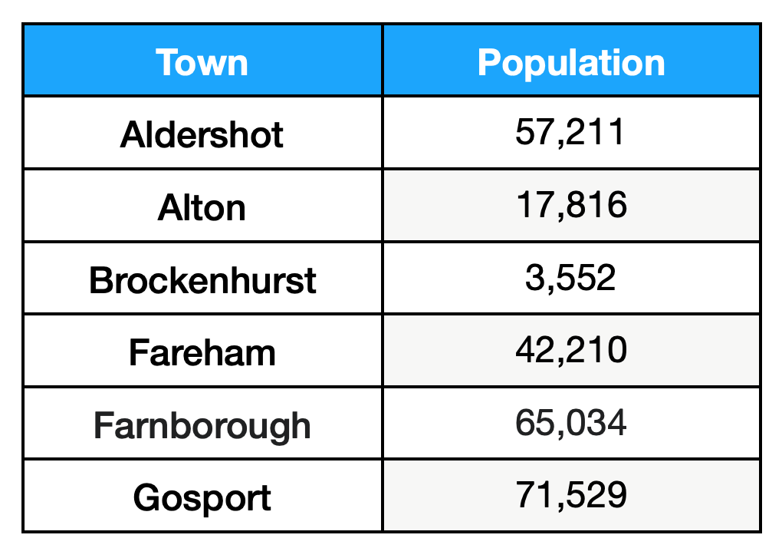
Understand the problem
HIAS Blended Learning Resource
Key fact: The population of Gosport is 71,529
Key fact: The population of Fareham is 42,210
Key fact: The population of Alton is 17,816
Key fact: The population of Brockenhurst is 3,552
We need to find out how many people live in Fareham, Alton and Brockenhurst altogether and find the difference between this total and the population of Gosport.
How much more is the population of Gosport than the combined populations of Fareham, Alton and Brockenhurst?

Slide 6
Make a Plan
HIAS Blended Learning Resource
Step 1: We need to visualise this problem so we can be sure we understand it fully. Representing the problem with bar models should help us.
Step 2: : We need to make sure our calculations are correct. Estimating these first will help us.
Step 3: We need to carry out our calculations and check these against our estimates.
Step 4:
We must provide the answer to the problem by stating how many more people live in Gosport than in Fareham, Alton and Brockenhurst combined.
How much more is the population of Gosport than the combined populations of Fareham, Alton and Brockenhurst?

Slide 7
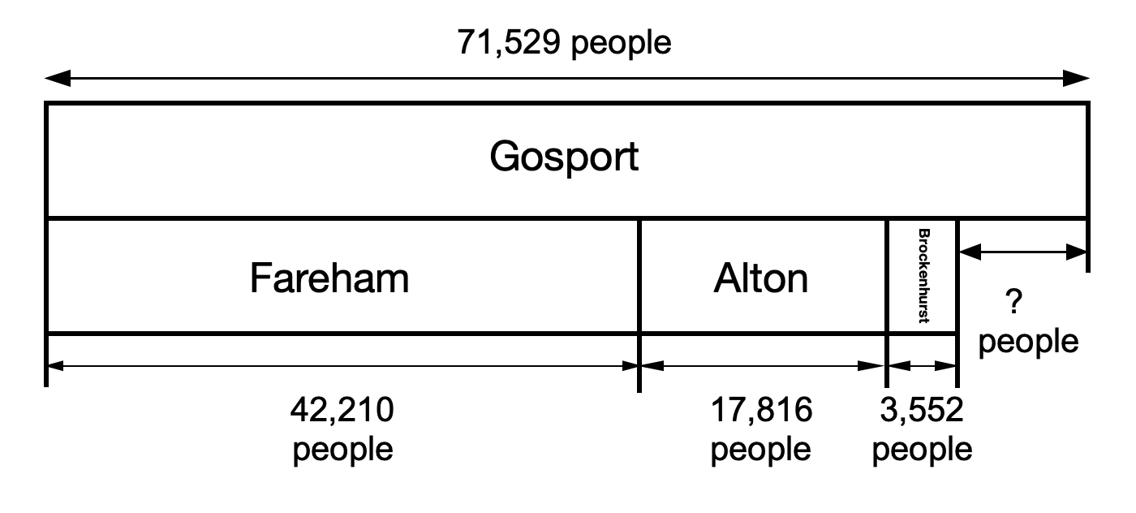

Slide 8
Carry out your plan: show your reasoning
HIAS Blended Learning Resource
Step 1: Draw the bar models and label them so we are clear in our understanding of the problem.
Add together the populations of Fareham (42,210), Alton (17,816) and Brockenhurst (3,552). This will give us their combined population total. Subtract this total from the population of Gosport (71,529). Then we will find out how much more the population of Gosport is than the combined populations of the other three towns.
Step 2: We need to estimate the answers to our calculations. Rounding the numbers to the nearest 1000 should help:
42,210 → 42,000
17,816 → 18,000
3,552 → 4,000
71,529 → 72,000
42,000 + 18,000 + 4,000 = 64,000
72,000 - 64000 = 8,000
Our answer will be approximately 8,000
Step 3: We need to carry out the calculations: and check these against our estimates:
42,210 + 17,816 + 3,552 = 63,578
71,529 - 63,578 = 7,951
This answer is very close to the estimate of 8000
Step 4:
We can now answer the problem:
The population of Gosport is 7,951 more than the combined populations of Fareham, Alton and Brockenhurst.
How much more is the population of Gosport than the combined populations of Fareham, Alton and Brockenhurst?

Slide 9
Review your solution: does it seem reasonable? Which steps/ parts did you find easy and which harder?
HIAS Blended Learning Resource
How could you check?
Go through the steps you took and check for errors
Remember to use the estimates.
You could use a different method to check your calculations (mental, jottings or formal written methods).
How much more is the population of Gosport than the combined populations of Fareham, Alton and Brockenhurst?

Slide 10
Now try this one
HIAS Blended Learning Resource
Understand the problem
Make a plan
Carry out your plan: show your reasoning
Review your solution: does it seem reasonable?
Think about your learning: which parts of the problem did you find easy and which parts did you find harder?
How much less is the population of Gosport than the combined populations of Farnborough, Alton and Brockenhurst?

Slide 11
HIAS Maths team
HIAS Blended Learning Resource
The HIAS maths team offer a wide range of high-quality services to support schools in improving outcomes for learners, including courses, bespoke consultancy and in-house training.
For further details referring to maths, please contact either of the team leads:
Jacqui Clifft : Jacqui.clifft@hants.gov.uk
Jo Lees: Jo.Lees@hants.gov.uk
For further details on the full range of services available please contact us using the following details:
Tel: 01962 874820 or email: hias.enquiries@hants.gov.uk
For further details on the full range of services available please contact us using the following details:
Tel: 01962 874820 or email: hias.enquiries@hants.gov.uk

