Slide 1
Year 1
HIAS Blended Learning Resource
1.8 Money- Counting in 2s, 5s, 10s
HIAS maths Team
Spring 2021
Final version
© Hampshire County Council

Slide 2
HIAS Blended Learning Resource
These slides are intended to support teachers and pupils with a blended approach to learning, either in-class or online. The tasks are intended to form part of a learning journey and could be the basis of either one lesson or a short sequence of connected lessons.
The 4-step Polya model for problem solving has been used to provide a structure to support reasoning. Teachers may need to use more or fewer steps to support the range of learners in their class.
Teachers should delete, change and add slides to suit the needs of their pupils. Extra slides with personalised prompts and appropriate examples based on previous teaching may be suitable. When changing the slide-deck, teachers should consider:
Their expectations for the use of representations such as bar models, number lines, arrays and diagrams.
Which strategies and methods pupils should use and record when solving problems or identifying solutions. This could include a range of informal jottings and diagrams, the use of tables to record solutions systematically and formal or informal calculation methods.
Teachers may also wish to record a ‘voice over’ to talk pupils through the slides.

Slide 3
HIAS Blended Learning Resource
1945 George Polya published ‘How To Solve It’ 2nd ed., Princeton University Press, 1957, ISBN 0-691-08097-6.

Slide 4
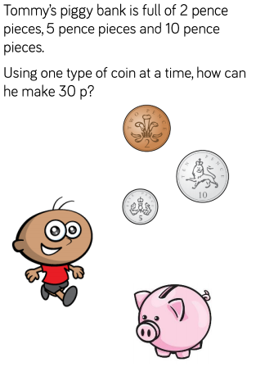
Maths focus: Counting in 2s, 5s, 10s in money context
HIAS Blended Learning Resource

Slide 5
Understand the problem
HIAS Blended Learning Resource
TASK
Count in 2 s until 30
Count in 5s until 30
Count in 10s until you get to 30
2, 4, 6, 8, 10, 12, 14, 16, 18, 20, 22, 24, 26, 28, 30
5, 10, 15, 20, 25, 30
10, 20, 30

Slide 6
Make a Plan
HIAS Blended Learning Resource
TASK
Step 1: Start with 1 coin. E.g. 10p. Count in 10s until you get to 30 keeping track on a number line.
Step 2: Count in 5s until you get to 30 keeping track on a number line.
Step 3: Count in 2s until you get to 30 keeping track on a number line.
Step 4
The number of coins you counted tells you how many of each type of coin is needed.

Slide 7
Step 1: Start with 1 coin. E.g. 10p. Count in 10s until you get to 30 keeping track on a number line.
Step 2: Count in 5s until you get to 30 keeping track on a number line.

Slide 8
Step 3: Count in 2s until you get to 30 keeping track on a number line.
Step 4
The number of coins you counted tells you how many of each type of coin is needed.
There are 15 coins.
There are 6 coins
There are 3 coins

Slide 9
Carry out your plan: show your reasoning
HIAS Blended Learning Resource
Step 1: 10, 20, 30
This is 3 coins
3 groups of 10 = 30
Step 2: 5, 10, 15, 20, 25, 30
This is 6 coins
6 groups of 5= 30
Step 3: 2 , 4, 6, 8, 10, 12, 14, 16, 18, 20, 22, 24, 26, 28, 30
This is 15 coins
15 groups of 2 = 30
Step 4: Record the answer for each coin.
TASK

Slide 10
Review your solution: does it seem reasonable? Which steps/ parts did you find easy and which harder?
HIAS Blended Learning Resource
TASK
How could you check?
Go through the steps you took and check for errors
Check by carefully counting again in steps of 2, 5, 10.
Touch each coin as you count to keep track.

Slide 11
Now try this one
HIAS Blended Learning Resource
Understand the problem
Make a plan
Carry out your plan: show your reasoning
Review your solution: does it seem reasonable?
Think about your learning: which parts of the problem did you find easy and which parts did you find harder?
TASK variation
How many different ways can you make 20p?
Record carefully. Change 1 coin type and swap for other at a time.

Slide 12
HIAS Maths team
HIAS Blended Learning Resource
The HIAS maths team offer a wide range of high-quality services to support schools in improving outcomes for learners, including courses, bespoke consultancy and in-house training.
For further details referring to maths, please contact either of the team leads:
Jacqui Clifft : Jacqui.clifft@hants.gov.uk
Jo Lees: Jo.Lees@hants.gov.uk
For further details on the full range of services available please contact us using the following details:
Tel: 01962 874820 or email: hias.enquiries@hants.gov.uk
For further details on the full range of services available please contact us using the following details:
Tel: 01962 874820 or email: hias.enquiries@hants.gov.uk

