Slide 1
Year 9
HIAS Blended Learning Resource
Proportion: Direct (unit 9.8)
Solve problems involving direct and inverse proportion, including graphical and algebraic representations
HIAS maths Team
Spring 2021
Final version
© Hampshire County Council

Slide 2
HIAS Blended Learning Resource
These slides are intended to support teachers and students with a blended approach to learning, either in-class or online. The tasks are intended to form part of a learning journey and could be the basis of either one lesson or a short sequence of connected lessons.
Teachers should delete, change and add slides to suit the needs of their students. Extra slides with personalised prompts and appropriate examples based on previous teaching may be suitable. When changing the slide-deck, teachers should consider:
Their expectations for the use of representations such as bar models, number lines, arrays and geometric diagrams.
Which strategies and methods students should use and record when solving problems or identifying solutions. This could include a range of informal jottings and diagrams, the use of tables to record solutions systematically and formal or informal calculation methods.
Teachers may also wish to record a ‘voice over’ to talk students through the slides.

Slide 3
HIAS Blended Learning Resource
YEAR 9: SPRING TERM OVERVIEW
Week | HIAS Unit | Topic
1 | Unit 9.6 | Probability: Sets and Venn diagrams
2 | Unit 9.7 | Statistics: Bivariate data
3 | Unit 9.8 | Proportion: Direct
4 |  | Proportion: Indirect
5 |  | Powers and roots
 | Half term
6 | Unit 7.9 | Approximation
7 |  | Compound units
8 | Unit 9.10 | Geometry: Pythagoras and trigonometry
9 |  | Geometry: Constructions
10 | Unit 9.11 | Algebra: Functions

Slide 4
HIAS Blended Learning Resource
Ellie and her dad walk side by side along a straight path. The number of steps they take is represented on a double number line and in a ratio table:
Which line represents Ellie’s steps and which represents her dad’s? Explain how you know.
When Ellie had taken 12 steps, her dad had taken 8 steps. When else were Ellie and her dad stepping at precisely the same time?
If they continued walking like this, find more points when they would be stepping at the same time. What is the connection between the number of Ellie’s steps and the number of her dad’s steps?
12
8
Adapted from NCETM
Mastery Professional Development
Notes:
Ellie’s steps are shown at the top as she has a shorter stride and therefore takes more steps in the same distance.
6 and 4 (half way)
18 and 12; 24 and 16 as Ellie’s steps are 1.5 times as many as that of her dad’s (the multiplier is 12÷8 = 1.5)

Slide 5
HIAS Blended Learning Resource
Ellie and her dad walk side by side along a straight path. The number of steps they take is represented here:
Which line represents Ellie’s steps and which represents her dad’s? Explain how you know.
When Ellie had taken 10 steps, her dad had taken 6 steps. When else were Ellie and her dad stepping at precisely the same time?
If they continued walking like this, find more points when they would be stepping at the same time. What is the connection between the number of Ellie’s dad’s steps and the number of Ellie’s steps?
 | 10
 | 6
Adapted from NCETM
Mastery Professional Development
Notes:
Ellie’s steps are shown at the top as she has a shorter stride and therefore takes more steps in the same distance.
5 and 3 (half way)
15 and 9 as Ellie’s dad’s steps are 0.6 x her steps (6 ÷ 10)

Slide 6
HIAS Blended Learning Resource
Here is another double number line.
Steve says that, to find the value of a, he is going to calculate 5 x 1.5
Mia says that she is going o find one quarter of 30.
Do you agree with Steve or Mia?
Explain how you know.
20 | 30
5 | a
Adapted from NCETM
Mastery Professional Development
Notes:
They are both correct:
Steve looked at the top number line and did 20 x 1.5 = 30 so that would work for the bottom number line 5 x 1.5 = 7.5
Mia looked at the point where 20 and 5 line up on both number lines. She noticed that 5 is ¼ of 20 (the multiplier is 0.25) and so found ¼ of 30 which is 7.5.

Slide 7
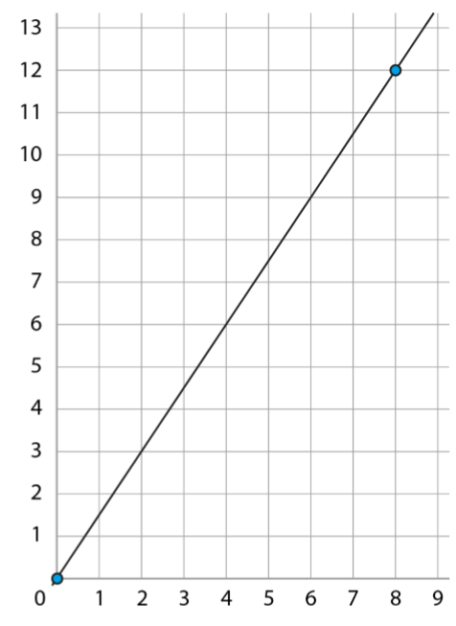
HIAS Blended Learning Resource
Ali buys eight identical packets of cakes for a birthday party. The total cost is £12.
Which line in the double number line below represents the number of packets of cakes Ali buys and which represents the total cost? Explain how you know.
Use the double number line or the graph to write down the cost of some other quantities of packets of cakes.
Can you write down roughly how much nine packets of cakes would cost? Can you be precise? Explain how.
12
8 | 9
Adapted from NCETM Mastery Professional Development
Notes:
The top line represents the cost as £12 matches with 8 packets of cakes.
The y axis shows cost, the x axis shows number of packets. £6 for 4 packets; £3 for 2 packets, £1.50 for 1 packet etc
Roughly 9 packets is £13.50 using the double number line. We can find out exactly as 9 x 1.5 (the multiplier) = 13.5

Slide 8
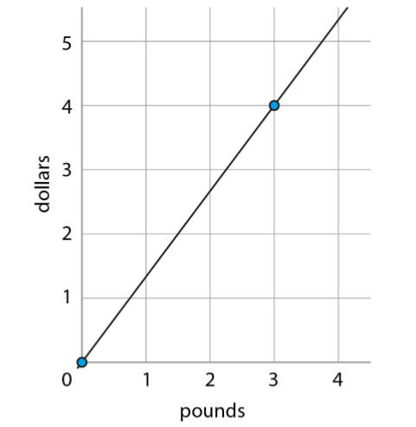
HIAS Blended Learning Resource
1. The double number line below can be used to convert between pounds and dollars. £3 is equivalent to $4.
Describe how you would use the double number line to roughly convert $4.50 to pounds.
Describe how you would use the double number line to accurately convert $4.50 to pounds. You could use the ratio table to help.
2. This graph can be used to convert between pounds and dollars.
What features of the graph show that the rate of exchange is £3 for every $4?
Describe how the graph would change if the rate of exchange changed to £3 for every $5?
3
4 | 4.5
Adapted from NCETM
Mastery Professional Development
Notes:
1a) See where $4.50 lines up with the pounds which looks like roughly £3.40
b) Use points that line up exactly to find the multiplier $4=£3 so the multiplier is 3÷4=0.75; and $4.50 x 0.75 = 3.375 so £3.38
2a) Where the line goes through the point (3, 4)
b) The graph would be steeper with the line going through the point (3, 5)

Slide 9
HIAS Maths team
HIAS Blended Learning Resource
The HIAS maths team offer a wide range of high-quality services to support schools in improving outcomes for learners, including courses, bespoke consultancy and in-house training.
For further details, please contact any member of the secondary maths team:
Jo Lees: Jo.Lees@hants.gov.uk
Jenny Burn: Jenny.Burn@hants.gov.uk
Tessa Ingrey: Tessa.Ingrey@hants.gov.uk
For further details on the full range of services available please contact us using the following details:
Tel: 01962 874820 or email: hias.enquiries@hants.gov.uk
For further details on the full range of services available please contact us using the following details:
Tel: 01962 874820 or email: hias.enquiries@hants.gov.uk

