Slide 1
Year 6
HIAS Blended Learning Resource
Fractions, Decimals and Percentages
HIAS maths Team
Spring 2021
Final version
© Hampshire County Council

Slide 2
HIAS Blended Learning Resource
These slides are intended to support teachers and pupils with a blended approach to learning, either in-class or online. The tasks are intended to form part of a learning journey and could be the basis of either one lesson or a short sequence of connected lessons.
The 4-step Polya model for problem solving has been used to provide a structure to support reasoning. Teachers may need to use more or fewer steps to support the range of learners in their class.
Teachers should delete, change and add slides to suit the needs of their pupils. Extra slides with personalised prompts and appropriate examples based on previous teaching may be suitable. When changing the slide-deck, teachers should consider:
Their expectations for the use of representations such as bar models, number lines, arrays and diagrams.
Which strategies and methods pupils should use and record when solving problems or identifying solutions. This could include a range of informal jottings and diagrams, the use of tables to record solutions systematically and formal or informal calculation methods.
Teachers may also wish to record a ‘voice over’ to talk pupils through the slides.

Slide 3
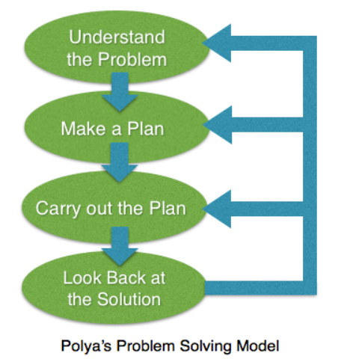
HIAS Blended Learning Resource
1945 George Polya published ‘How To Solve It’ 2nd ed., Princeton University Press, 1957, ISBN 0-691-08097-6.

Slide 4
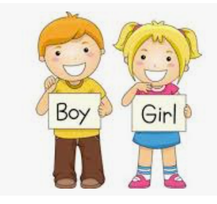
Solve problems involving ratio and proportion
HIAS Blended Learning Resource
There are 32 children in the class.
There is 1 boy for every 3 girls
How many girls are in the class?
TTS Graded Problem Solving Card Year 6

Slide 5
Understand the problem
HIAS Blended Learning Resource
There are 32 children in the class.
There is 1 boy for every 3 girls
How many girls are in the class?
TTS Graded Problem Solving Card Year 6
There was a class of children with boys and girls.
Key fact: There are 32 children in total in the class.
Key fact: There are more girls than boys in the class.
Key fact: For every 1 boy there are 3 girls.
Key fact: Written as a ratio this becomes 1:3
The answer will be less than 32 but more than a half of 32.

Slide 6
Make a Plan
HIAS Blended Learning Resource
Step 1:
Draw the bar model that represents the whole and the boy/girl ratio to make one group of girls and boys
Step 2:
Find out how many groups of 1 boy and 3 girls are in a class of 32.
Step 3:
Multiply the 3 girls by the number of groups of 3 girls there are in the class to find the total amount of girls in the class.
There are 32 children in the class.
There is 1 boy for every 3 girls
How many girls are in the class?
TTS Graded Problem Solving Card Year 6

Slide 8
Carry out your plan: show your reasoning
HIAS Blended Learning Resource
Step 1:
Draw the bar model to show the whole class and the one group of pupils that shows 1 boy and 3 girls. This makes a group of 4 children in total.
Step 2:
Find out how many groups of 4 are in 32 by dividing 32 by 4.
32 ÷ 4 = 8
There are 8 groups of 4 children in the class
Step 3:
In every group there are 3 girls and if there are 8 groups in total then multiply 3 by 8
3(girls) x 8 (number of groups) = 24
There are 32 children in the class.
There is 1 boy for every 3 girls
How many girls are in the class?
TTS Graded Problem Solving Card Year 6

Slide 9
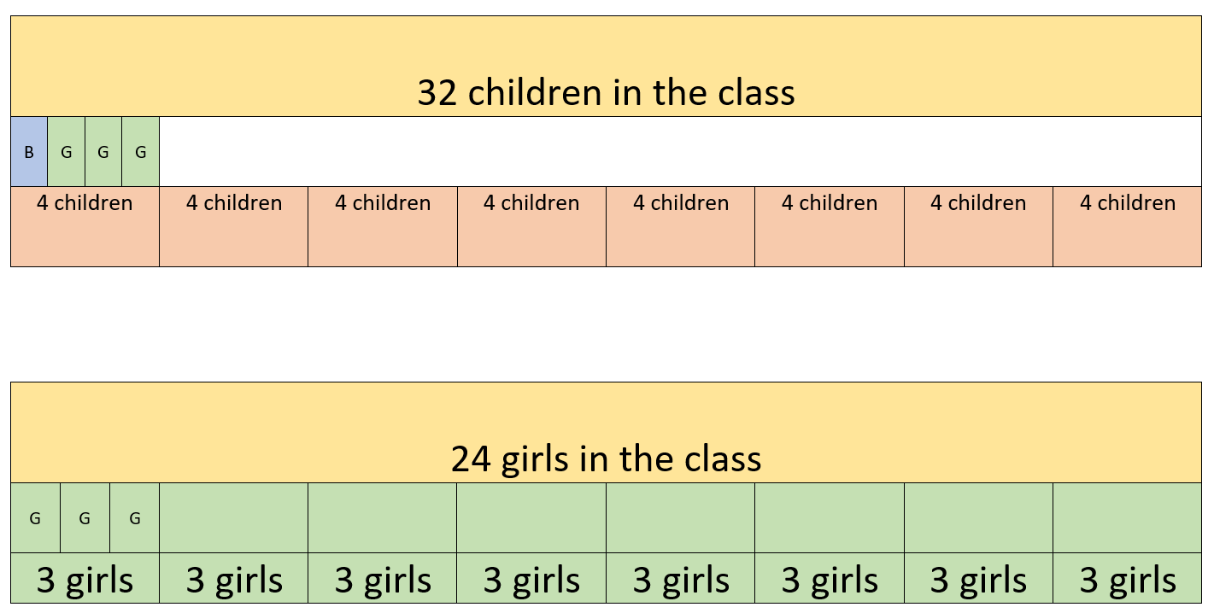
How many groups of 4 are in 32? 32 ÷ 4 = 8
There are 8 groups of 4 in 32.
There are 8 groups and 3 girls are in every group.
3 x 8 = 24
There are 24 girls in the class

Slide 10
Review your solution: does it seem reasonable? Which steps/ parts did you find easy and which harder?
HIAS Blended Learning Resource
There are 32 children in the class.
There is 1 boy for every 3 girls
How many girls are in the class?
TTS Graded Problem Solving Card Year 6
How could you check?
Go through the steps you took and check for errors.
Is your answer the number of girls there are in the class? If you then work out how many boys there are, is there more girls than boys?
2. Try to solve the calculation a different way and see if you get the same answer

Slide 11
Now try this one
HIAS Blended Learning Resource
Understand the problem
Make a plan
Carry out your plan: show your reasoning
Review your solution: does it seem reasonable?
Think about your learning: which parts of the problem did you find easy and which parts did you find harder?
There are 36 children in the class.
There is 1 boy for every 5 girls
How many girls are in the class?

Slide 12
HIAS Maths team
HIAS Blended Learning Resource
The HIAS maths team offer a wide range of high-quality services to support schools in improving outcomes for learners, including courses, bespoke consultancy and in-house training.
For further details referring to maths, please contact either of the team leads:
Jacqui Clifft : Jacqui.clifft@hants.gov.uk
Jo Lees: Jo.Lees@hants.gov.uk
For further details on the full range of services available please contact us using the following details:
Tel: 01962 874820 or email: hias.enquiries@hants.gov.uk
For further details on the full range of services available please contact us using the following details:
Tel: 01962 874820 or email: hias.enquiries@hants.gov.uk

