Slide 1
Year 7
HIAS Blended Learning Resource
Percentages (FDP equivalence) (unit 7.9)
This unit is about percentages and ratio. Students will develop an understanding of percentages as parts per hundred and how this links to fraction and decimal notations. They will solve problems involving percentages in the context of measure and pure number to make links across the domains. The idea of parts and the whole is explored using ratio notation. Students will use multiplicative knowledge to simplify ratios and divide quantities into equal and unequal parts.
This set of problems is about the equivalence between fractions, decimals and percentages
HIAS maths Team
Spring 2021
Final version
© Hampshire County Council

Slide 2
HIAS Blended Learning Resource
These slides are intended to support teachers and students with a blended approach to learning, either in-class or online. The tasks are intended to form part of a learning journey and could be the basis of either one lesson or a short sequence of connected lessons.
Teachers should delete, change and add slides to suit the needs of their students. Extra slides with personalised prompts and appropriate examples based on previous teaching may be suitable. When changing the slide-deck, teachers should consider:
Their expectations for the use of representations such as bar models, number lines, arrays and geometric diagrams.
Which strategies and methods students should use and record when solving problems or identifying solutions. This could include a range of informal jottings and diagrams, the use of tables to record solutions systematically and formal or informal calculation methods.
Teachers may also wish to record a ‘voice over’ to talk students through the slides.

Slide 3
HIAS Blended Learning Resource
YEAR 7: SPRING TERM OVERVIEW
Week | HIAS Unit | Topic
1 | Unit 7.6 | Four operations: Fractions (vulgar and decimal)
2 | Unit 7.7 | Probability: 0-1 scale
3 | Unit 7.8 | Geometry: Polygons
4 |  | Geometry: Area
5 |  | Geometry: Volume and 3-D shape
 | Half term
6 | Unit 7.9 | Percentages (of amounts)
7 |  | Percentages (FDP equivalence)
8 |  | Ratio and proportion: Notation and part: whole
9 | Unit 7.10 | Coordinates (four quadrants)
10 |  | Coordinates (linear functions )

Slide 4
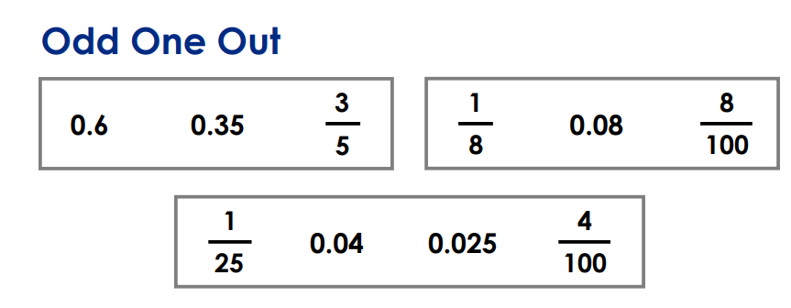
HIAS Blended Learning Resource
$$\frac{1}{4}$$
$$\frac{3}{5}$$
$$\frac{75}{100}$$
0.5
50%
75%
$$\frac{1}{10}$$
$$\frac{10}{100}$$
0.01
0.1
Adapted from ‘I See Reasoning’ by Gareth Metcalfe
For each set in a box, choose the odd one out and explain why
Notes:
Solutions:
Discuss equivalences and the need to change each set into the same ‘format’
0.5 = 50% ≠$\frac{1}{4}$
75% = $\frac{75}{100}$ ≠$\frac{3}{5}$
0.1 = $\frac{10}{100}$ = $\frac{1}{10}$ ≠0.01

Slide 5
HIAS Blended Learning Resource
$$\frac{3}{2}$$
$$\frac{3}{10}$$
$$\frac{3}{100}$$
1.5
50%
30%
$$\frac{2}{4}$$
$$\frac{50}{100}$$
0.2
0.5
Adapted from ‘I See Reasoning’ by Gareth Metcalfe
For each set in a box, choose the odd one out and explain why
Notes:
Solutions:
Discuss equivalences and the need to change each set into the same ‘format’
1.5 = $\frac{3}{2}$ ≠50%
30% = $\frac{3}{10}$ ≠$\frac{3}{100}$
0.5 = $\frac{2}{4}$ = $\frac{50}{100}$ ≠0.2

Slide 6
HIAS Blended Learning Resource
Taken from ‘I See Reasoning’ by Gareth Metcalfe
For each set in a box, choose the odd one out and explain why
Notes:
Solutions:
Discuss equivalences and the need to change each set into the same ‘format’
0.6 = $\frac{3}{5}$ ≠0.35
0.08 = $\frac{8}{100}$ ≠$\frac{1}{8}$
0.04 = $\frac{1}{25}$ = $\frac{4}{100}$ ≠0.025

Slide 7
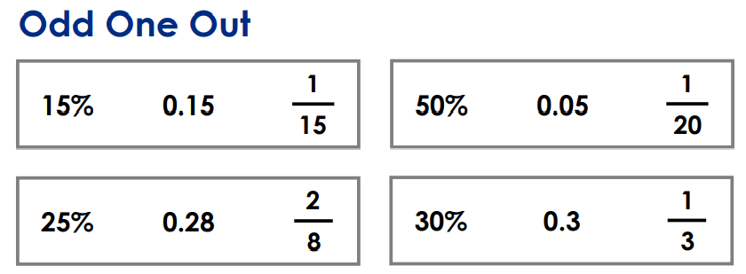
HIAS Blended Learning Resource
Identify a decimal and two fractions that are equivalent to 8%
Taken from ‘I See Reasoning’ by Gareth Metcalfe
For each set in a box, choose the odd one out and explain why
Notes:
Solutions:
Discuss equivalences and the need to change each set into the same ‘format’
0.15 =15% ≠ $\frac{1}{15}$
$\frac{1}{20}$ =0.05 ≠50%
25% = $\frac{2}{8}$ ≠ 0.28
30% = 0.3 ≠ $\frac{1}{3}$
8% = 0.08 = $\frac{8}{100}$ = $\frac{4}{50}$

Slide 8
HIAS Blended Learning Resource
$$\frac{5}{4}$$
$$\frac{3}{9}$$
$$\frac{5}{15}$$
1.25
25%
30%
$$\frac{1}{17}$$
$$\frac{34}{200}$$
0.17
17%
Identify a decimal , a fraction, a mixed number and a percentage
that are equivalent to $\frac{7}{5}$
Adapted from ‘I See Reasoning’ by Gareth Metcalfe
For each set in a box, choose the odd one out and explain why
Notes:
Solutions:
Discuss equivalences and the need to change each set into the same ‘format’
1.25 = $\frac{5}{4}$ ≠ 25%
$\frac{3}{9}$ =$\frac{5}{15}$ ≠30%
0.17 = $\frac{34}{100}$ = 17% ≠$\frac{1}{17}$
$\frac{7}{5}$ = $\frac{14}{10}$ =1 $\frac{2}{5}$ = 1.4 = 140%

Slide 9
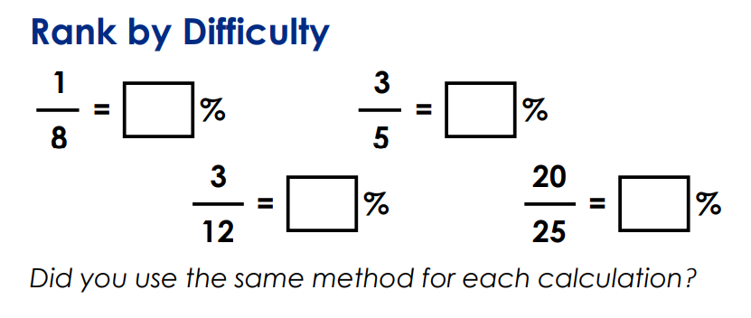
HIAS Blended Learning Resource
Taken from ‘I See Reasoning’ by Gareth Metcalfe
Notes:
Solutions
12.5 % = $\frac{1}{8}$
60 % = $\frac{3}{5}$
25 % = $\frac{3}{12}$
12.5 % = $\frac{1}{8}$
80% = $\frac{20}{25}$

Slide 10
HIAS Maths team
HIAS Blended Learning Resource
The HIAS maths team offer a wide range of high-quality services to support schools in improving outcomes for learners, including courses, bespoke consultancy and in-house training.
For further details, please contact any member of the secondary maths team:
Jo Lees: Jo.Lees@hants.gov.uk
Jenny Burn: Jenny.Burn@hants.gov.uk
Tessa Ingrey: Tessa.Ingrey@hants.gov.uk
For further details on the full range of services available please contact us using the following details:
Tel: 01962 874820 or email: hias.enquiries@hants.gov.uk
For further details on the full range of services available please contact us using the following details:
Tel: 01962 874820 or email: hias.enquiries@hants.gov.uk

