Slide 1
Year 3
HIAS Blended Learning Resource
Addition and Subtraction
Solve number problems and practical problems in the context of measurement
HIAS maths Team
Spring 2021
Final version
© Hampshire County Council

Slide 2
HIAS Blended Learning Resource
These slides are intended to support teachers and pupils with a blended approach to learning, either in-class or online. The tasks are intended to form part of a learning journey and could be the basis of either one lesson or a short sequence of connected lessons.
The 4-step Polya model for problem solving has been used to provide a structure to support reasoning. Teachers may need to use more or fewer steps to support the range of learners in their class.
Teachers should delete, change and add slides to suit the needs of their pupils. Extra slides with personalised prompts and appropriate examples based on previous teaching may be suitable. When changing the slide-deck, teachers should consider:
Their expectations for the use of representations such as bar models, number lines, arrays and diagrams.
Which strategies and methods pupils should use and record when solving problems or identifying solutions. This could include a range of informal jottings and diagrams, the use of tables to record solutions systematically and formal or informal calculation methods.
Teachers may also wish to record a ‘voice over’ to talk pupils through the slides.

Slide 3
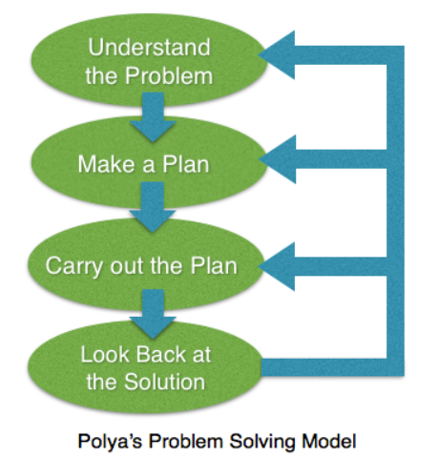
HIAS Blended Learning Resource
1945 George Polya published ‘How To Solve It’ 2nd ed., Princeton University Press, 1957, ISBN 0-691-08097-6.

Slide 4
Solving number problems in the context of measurement
HIAS Blended Learning Resource
TASK
Amy plants a sunflower seed.
After 4 months, the sunflower has grown 226cm tall.
It grows 40cm after another month.
Amy’s friend, Sophie, also grows a sunflower.
Hers is 256cm tall.
Who has the tallest sunflower and by how much?
Adapted from ‘Dip and Pick’

Slide 5
Understand the problem
HIAS Blended Learning Resource
Amy and Sophie have grown sunflowers.
Key Fact: Amy’s sunflower is 226cm tall and grows 40cm more.
Have to work out the total height of Amy’s sunflower.
Key fact: Sophie’s sunflower is 256cm tall.
Have to work out who has the tallest sunflower and by how much.
TASK
Amy plants a sunflower seed.
After 4 months, the sunflower has grown 226cm tall.
It grows 40cm after another month.
Amy’s friend, Sophie, also grows a sunflower.
Hers is 256cm tall.
Who has the tallest sunflower and by how much?
Adapted from ‘Dip and Pick’

Slide 6
Make a Plan
HIAS Blended Learning Resource
Step 1: Calculate the total height of Amy’s sunflower
Step 2: Compare the height of Amy’s sunflower with the height of Sophie’s sunflower to see who has the tallest sunflower
Step 3: Calculate the difference in height between the two sunflowers
TASK
Amy plants a sunflower seed.
After 4 months, the sunflower has grown 226cm tall.
It grows 40cm after another month.
Amy’s friend, Sophie, also grows a sunflower.
Hers is 256cm tall.
Who has the tallest sunflower and by how much?
Adapted from ‘Dip and Pick’

Slide 7
We could represent the problem on a bar model:
We could use a number line to calculate the total:
226cm
40cm
Total height of Amy’s sunflower

Slide 8
Carry out your plan: show your reasoning
HIAS Blended Learning Resource
Step 1: Calculate the total height of Amy’s sunflower
226cm + 40cm =
Step 2: Compare the height of Amy’s sunflower with the height of Sophie’s sunflower to see who has the tallest sunflower
Compare 226cm + 40cm = with
256cm.
Step 3: Calculate the difference in height between the two sunflowers
Explain who has the tallest sunflower and by how much.
TASK
Amy plants a sunflower seed.
After 4 months, the sunflower has grown 226cm tall.
It grows 40cm after another month.
Amy’s friend, Sophie, also grows a sunflower.
Hers is 256cm tall.
Who has the tallest sunflower and by how much?
Adapted from ‘Dip and Pick’

Slide 9
Step 1: 226cm + 40cm = ?
The total height of Amy’s sunflower is 266cm.
Step 2: Compare the height of Amy’s sunflower with the height of Sophie’s sunflower to see who has the tallest sunflower
Amy’s sunflower is 266cm tall. Sophie’s sunflower is 256cm tall. Amy has the tallest sunflower because 266cm is larger (taller) than 256cm.
Step 3: Calculate the difference in height between the two sunflowers
You could ‘count up’ on a number line to find the difference in height.
Amy’s sunflower is 10cm taller than Sophie’s sunflower.
226cm
40cm
266cm

Slide 10
Review your solution: does it seem reasonable? Which steps/ parts did you find easy and which harder?
HIAS Blended Learning Resource
How could you check?
Go through the steps you took and check for errors
Remember the question is about finding the
total height of Amy’s sunflower and
comparing it with the height of Sophie’s
sunflower.
Try to solve the calculation a
different way and see if you get the
same answer
Could you use the inverse to check?
TASK
Amy plants a sunflower seed.
After 4 months, the sunflower has grown 226cm tall.
It grows 40cm after another month.
Amy’s friend, Sophie, also grows a sunflower.
Hers is 256cm tall.
Who has the tallest sunflower and by how much?
Adapted from ‘Dip and Pick’

Slide 11
Now try this one
HIAS Blended Learning Resource
Understand the problem
Make a plan
Carry out your plan: show your reasoning
Review your solution: does it seem reasonable?
Think about your learning: which parts of the problem did you find easy and which parts did you find harder?
TASK
Sophie needs a cane to support her sunflower.
Her sunflower was 256cm but it has grown by 40cm.
Will a cane that is 3m be tall enough to support the whole of her sunflower?
Explain how you know.
Adapted from ‘Dip and Pick’

Slide 12
HIAS Maths team
HIAS Blended Learning Resource
The HIAS maths team offer a wide range of high-quality services to support schools in improving outcomes for learners, including courses, bespoke consultancy and in-house training.
For further details referring to maths, please contact either of the team leads:
Jacqui Clifft : Jacqui.clifft@hants.gov.uk
Jo Lees: Jo.Lees@hants.gov.uk
For further details on the full range of services available please contact us using the following details:
Tel: 01962 874820 or email: hias.enquiries@hants.gov.uk
For further details on the full range of services available please contact us using the following details:
Tel: 01962 874820 or email: hias.enquiries@hants.gov.uk

