Slide 1
Year 7
HIAS Blended Learning Resource
Coordinates in four quadrants (unit 7.10)
This unit is about coordinates and linear functions
This set of problems is about missing coordinates of vertices and mid-points on shapes
HIAS maths Team
Spring 2021
Final version
© Hampshire County Council

Slide 2
HIAS Blended Learning Resource
These slides are intended to support teachers and students with a blended approach to learning, either in-class or online. The tasks are intended to form part of a learning journey and could be the basis of either one lesson or a short sequence of connected lessons.
Teachers should delete, change and add slides to suit the needs of their students. Extra slides with personalised prompts and appropriate examples based on previous teaching may be suitable. When changing the slide-deck, teachers should consider:
Their expectations for the use of representations such as bar models, number lines, arrays and geometric diagrams.
Which strategies and methods students should use and record when solving problems or identifying solutions. This could include a range of informal jottings and diagrams, the use of tables to record solutions systematically and formal or informal calculation methods.
Teachers may also wish to record a ‘voice over’ to talk students through the slides.

Slide 3
HIAS Blended Learning Resource
YEAR 7: SPRING TERM OVERVIEW
Week | HIAS Unit | Topic
1 | Unit 7.6 | Four operations: Fractions (vulgar and decimal)
2 | Unit 7.7 | Probability: 0-1 scale
3 | Unit 7.8 | Geometry: Polygons
4 |  | Geometry: Area
5 |  | Geometry: Volume and 3-D shape
 | Half term
6 | Unit 7.9 | Percentages (of amounts)
7 |  | Percentages (FDP equivalence)
8 |  | Ratio and proportion: Notation and part: whole
9 | Unit 7.10 | Coordinates (four quadrants)
10 |  | Coordinates (linear functions )

Slide 4
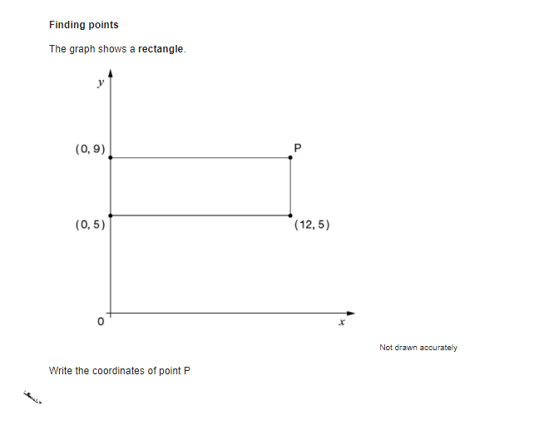
HIAS Blended Learning Resource
Finding points
The graph shows a square
What are the coordinates of P ?
(0, 3)
P
= (x, y)
x
x
(0 , 1)
x
x
(3 , 1)
Adapted from ‘Test Base’
Notes:
Solution
P = (3,3)

Slide 5
HIAS Blended Learning Resource
Taken from ‘Test Base’
Notes:
Solution
P = (12,9)

Slide 6
HIAS Blended Learning Resource
Finding points
The graph shows a rectangle
What are the coordinates of P and Q ?
(8 , 10)
P
Q
Adapted from ‘Test Base’
Notes:
Solution
P = (0,10)
Q = (8, 5)

Slide 7
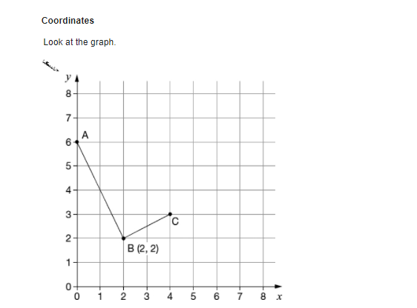
HIAS Blended Learning Resource
What are the coordinates of points A and C?
ABCD is a rectangle
What are the coordinates of point D?
Taken from ‘Test Base’
Notes:
Solutions
A = (0 , 6)
C = (4 , 3)
D = (2 , 7)

Slide 8
HIAS Blended Learning Resource
Finding points
The graph shows an isosceles triangle
What are the coordinates of P?
y
(0 , 5)
x
P
(3 , -3)
Adapted from ‘Test Base’
Notes:
Solution
P = (-3, -3)

Slide 9
HIAS Blended Learning Resource
Finding points
The graph shows an isosceles trapezium with the y-axis as a mirror line
What are the coordinates of P and Q?
y
(0 , 5)
( 2 , -1)
x
P
( -4 , -7)
Q
Adapted from ‘Test Base’
Notes:
Solution
P = (-2,-1)
Q = (4, -7)

Slide 10
HIAS Blended Learning Resource
Taken from ‘Test Base’
Notes:
Solutions
K = (5 , 2)
D = (2 , 1)

Slide 11
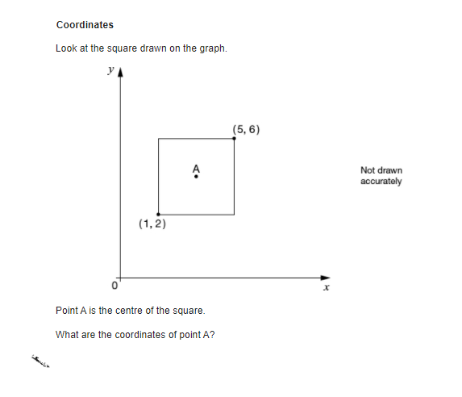
HIAS Blended Learning Resource
Coordinates
Look at the square drawn on the graph
Point A is in the centre of the square
(4 , 4)
(2 , 2)
What are the coordinates of point A?
You can use the dotted lines to help you
You might find it helpful to add in coordinates of the other two vertices
Adapted from ‘Test Base’
Notes:
Solutions
A = (3, 3)

Slide 12
HIAS Blended Learning Resource
Taken from ‘Test Base’
Notes:
Solutions
A = (3 , 4)

Slide 13
HIAS Blended Learning Resource
Taken from ‘Test Base’
Notes:
Solutions
C = (6 , 7) , (6 , 8), (6, 3) (anywhere on the line x=6)
C = (4 , 5) or (8 , 5)

Slide 14
HIAS Maths team
HIAS Blended Learning Resource
The HIAS maths team offer a wide range of high-quality services to support schools in improving outcomes for learners, including courses, bespoke consultancy and in-house training.
For further details, please contact any member of the secondary maths team:
Jo Lees: Jo.Lees@hants.gov.uk
Jenny Burn: Jenny.Burn@hants.gov.uk
Tessa Ingrey: Tessa.Ingrey@hants.gov.uk
For further details on the full range of services available please contact us using the following details:
Tel: 01962 874820 or email: hias.enquiries@hants.gov.uk
For further details on the full range of services available please contact us using the following details:
Tel: 01962 874820 or email: hias.enquiries@hants.gov.uk

