Slide 1
Year 8
HIAS Blended Learning Resource
Statistics: Graphs, charts and averages for numerical data (unit 8.9)
Construct and interpret appropriate tables, charts and diagrams, including frequency tables, bar charts, pie charts and pictograms for categorical data
Construct and interpret vertical line (or bar) charts for ungrouped numerical data and grouped numerical data.
Calculate and interpret measures of central tendency and spread, including consideration of outliers.
HIAS maths Team
Spring 2021
Final version
© Hampshire County Council

Slide 2
HIAS Blended Learning Resource
These slides are intended to support teachers and students with a blended approach to learning, either in-class or online. The tasks are intended to form part of a learning journey and could be the basis of either one lesson or a short sequence of connected lessons.
Teachers should delete, change and add slides to suit the needs of their students. Extra slides with personalised prompts and appropriate examples based on previous teaching may be suitable. When changing the slide-deck, teachers should consider:
Their expectations for the use of representations such as bar models, number lines, arrays and geometric diagrams.
Which strategies and methods students should use and record when solving problems or identifying solutions. This could include a range of informal jottings and diagrams, the use of tables to record solutions systematically and formal or informal calculation methods.
Teachers may also wish to record a ‘voice over’ to talk students through the slides.

Slide 3
HIAS Blended Learning Resource
YEAR 8 : SPRING TERM OVERVIEW
Week | HIAS Unit | Topic
1 | Unit 8.6 | Geometry: Formulae for perimeters and areas
2 | Unit 8.7 | Accuracy, powers, and roots
3 | Unit 8.8 | Compound measures
4 | Unit 8.9 | Statistics: Graphs and charts
5 |  | Statistics: averages for numerical data
 | Half term
6 | Unit 8.10 | Number: Standard form (representing numbers)
 |  | Number: Standard form (simple calculations)
7 |  | Number: Standard form (simple calculations)
 |  | Number: Prime factorisations
8 |  | Number: Prime factorisations
9 | Unit 8.11 | Graphs: Linear and quadratic
10 |  | Graphs: Simultaneous equations

Slide 4
HIAS Blended Learning Resource
There are five people in the Baker family.
The mean of the ages of four of them is 24.5, the mean of all five members of the family is 22.
What is the age of the person who has now been included?
Notes:
Solution:
24.5x4 = 98
22x5= 110
Difference is 12, therefore the person who has now been included is 12 years old

Slide 5
HIAS Blended Learning Resource
There are five people in the Green family, there are three children, which includes twins.
The mean age of the children is 16 years. What ages could the children be? Give at least 3 possibilities.
The mean age of the family is 26 years, what is the sum of the adults ages?
Notes:
Solution 1:
2 ages are the same and the total of their ages is 16x3 = 48
20, 20, 8
19, 19, 10
18, 18, 12
17, 17, 14
15, 15, 18
14, 14, 20
13, 13, 22
16 doesn’t work as the children would all be the same age
Solution 2:
26 x 5 = 130 (total of ages of all family)
16x3 = 48 (total of children’s ages)
130 – 48 = 82 (sum of adults ages)

Slide 6
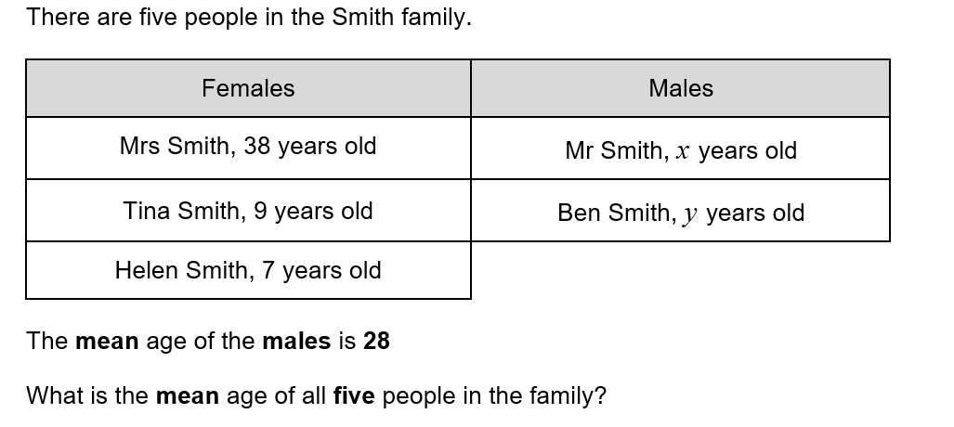
HIAS Blended Learning Resource
Adapted from Testbase
Notes:
Solution:
Total of males ages is 28 x 2 = 56
Mean of all ages is (38 + 9 + 7 +56)÷5 = 22 years

Slide 7
HIAS Blended Learning Resource
The mean age of a group of five children is 6, what could their ages be?
If the mean age of a group of five children is 6 and the mode of their ages is 4, what could their ages be?
The mean and median age of a group of five children is 6, what could their ages be?
The mean and median age of a group of five children is 6, the mode is 4, what is the range of their ages?
Testbase question
Notes:
Solution 1:
5x6=30 so total of ages is 30
3, 4, 6, 7, 10
Solution 2:
30 – 8 = 22 so other 3 ages need to sum to 22
3, 4, 4, 7, 12 2, 4, 4, 8, 12 1, 4, 4, 9, 12 etc
Solution 3:
6 is the middle number, and the total of 5 ages is 30
4, 5, 6, 7, 8 3, 5, 6, 7, 9 etc
Solution 4:
6 is the middle number, the total of 5 ages is 30 and the most frequent age is 4
4, 4, 6, 7, 9

Slide 8
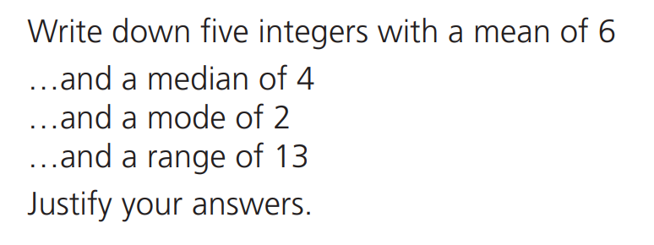
HIAS Blended Learning Resource
Notes:
Solution 1:
6, 6, 6, 6, 6 4, 5, 6, 7, 8 3, 4, 6, 8, 9 etc
Sum of each group is 30, then dividing by 5 gives a mean of 6
Solution 2:
2, 3, 4, 10, 11 2, 3, 4, 9, 12 1, 2, 4, 10, 13 etc
Sum of each group is 30, the middle value has to be 4
This means that the remaining 4 values sum to 26, with 2 values less than or equal to 4 and 2 values greater than or equal to 4
Solution 3:
Sum of each group is 30, the middle value has to be 4 and the most frequent number is 2.
This means the first 3 values are: 2, 2, 4. the remaining 2 values have to sum to 22
2, 2, 4, 10, 12 2, 2, 4, 9, 13 2, 2, 4, 8, 14 etc
Solution 4:
Sum of each group is 30, the middle value has to be 4 and the most frequent number is 2.
This means the first 3 values are: 2, 2, 4.
The difference between the smallest and largest value is 13, therefore the largest value has to be 15 as we know the smallest value is 2.
2, 2, 4, 7, 15

Slide 9
HIAS Maths team
HIAS Blended Learning Resource
The HIAS maths team offer a wide range of high-quality services to support schools in improving outcomes for learners, including courses, bespoke consultancy and in-house training.
For further details, please contact any member of the secondary maths team:
Jo Lees: Jo.Lees@hants.gov.uk
Jenny Burn: Jenny.Burn@hants.gov.uk
Tessa Ingrey: Tessa.Ingrey@hants.gov.uk
For further details on the full range of services available please contact us using the following details:
Tel: 01962 874820 or email: hias.enquiries@hants.gov.uk
For further details on the full range of services available please contact us using the following details:
Tel: 01962 874820 or email: hias.enquiries@hants.gov.uk

