Slide 1
Year 7
HIAS Blended Learning Resource
Fractions and decimals (unit 7.6)
This unit is about calculating with part and whole numbers.
The focus is on calculation with proper and improper fractions and their decimal equivalents.
This set of problems is about multiplying with fractions, with solutions as proper and improper fractions , also considering the decimal equivalents.
HIAS maths Team
Spring 2021
Final version
© Hampshire County Council

Slide 2
HIAS Blended Learning Resource
These slides are intended to support teachers and students with a blended approach to learning, either in-class or online. The tasks are intended to form part of a learning journey and could be the basis of either one lesson or a short sequence of connected lessons.
Teachers should delete, change and add slides to suit the needs of their students. Extra slides with personalised prompts and appropriate examples based on previous teaching may be suitable. When changing the slide-deck, teachers should consider:
Their expectations for the use of representations such as bar models, number lines, arrays and geometric diagrams.
Which strategies and methods students should use and record when solving problems or identifying solutions. This could include a range of informal jottings and diagrams, the use of tables to record solutions systematically and formal or informal calculation methods.
Teachers may also wish to record a ‘voice over’ to talk students through the slides.

Slide 3
HIAS Blended Learning Resource
YEAR 7: SPRING TERM OVERVIEW
Week | HIAS Unit | Topic
1 | Unit 7.6 | Four operations: Fractions (vulgar and decimal)
2 | Unit 7.7 | Probability: 0-1 scale
3 | Unit 7.8 | Geometry: Polygons
4 |  | Geometry: Constructions
5 |  | Geometry: Volume and 3-D shape
 | Half term
6 | Unit 7.9 | Percentages (of amounts)
7 |  | Percentages (FDP equivalence)
8 |  | Ratio and proportion: Notation and part: whole
9 | Unit 7.10 | Coordinates (four quadrants)
10 |  | Coordinates (linear functions )

Slide 4
HIAS Blended Learning Resource
I know ……so…….
Here are the first 5 multiples in the $\frac{1}{2}$ times table
1 x $\frac{1}{2}$ = $\frac{1}{2}$
2 x $\frac{1}{2}$ = 1
3 x $\frac{1}{2}$ = 1$\frac{1}{2}$
4 x $\frac{1}{2}$ = 2
5 x $\frac{1}{2}$ = 2$\frac{1}{2}$
Use this information to find:
6 x $\frac{1}{2}$ = □
11 x $\frac{1}{2}$ = □
□ x $\frac{1}{2}$ = 15
0.5
1.0
1.5
2.0
2.5
3.0
3.5
4.0
4.5
0
$$\frac{1}{2}$$
$$\frac{2}{2}$$
$$\frac{3}{2}$$
$$\frac{4}{2}$$
$$\frac{5}{2}$$
$$\frac{6}{2}$$
$$\frac{7}{2}$$
$$\frac{8}{2}$$
$$\frac{9}{2}$$
Notes:
Solutions
6 x $\frac{1}{2}$ = 3
11 x $\frac{1}{2}$ = 5$\frac{1}{2}$
30 x $\frac{1}{2}$ = 15

Slide 5
HIAS Blended Learning Resource
I know ……so…….
Here are the first 5 multiples in the $\frac{1}{4}$ times table
1 x $\frac{1}{4}$ = $\frac{1}{4}$
2 x $\frac{1}{4}$ = $\frac{1}{2}$
3 x $\frac{1}{4}$ = $\frac{3}{4}$
4 x $\frac{1}{4}$ = 1
5 x $\frac{1}{4}$ = 1$\frac{1}{4}$
Use this information to find:
8 x $\frac{1}{4}$ = □
13 x $\frac{1}{4}$ = □
□ x $\frac{1}{4}$ = 8
0.25
0.5
0.75
1.0
1.25
1.5
1.75
2.0
2.25
0
$$\frac{1}{4}$$
$$\frac{2}{4}$$
$$\frac{3}{4}$$
$$\frac{4}{4}$$
$$\frac{5}{4}$$
$$\frac{6}{4}$$
$$\frac{7}{4}$$
$$\frac{8}{4}$$
$$\frac{9}{4}$$
Notes:
Solutions
8 x $\frac{1}{4}$ = 2
13 x $\frac{1}{4}$ = 3$\frac{1}{4}$
32 x $\frac{1}{4}$ = 8

Slide 6
HIAS Blended Learning Resource
I know ……so…….
Here are the first 5 multiples in the $\frac{3}{4}$ times table
1 x $\frac{3}{4}$ = $\frac{3}{4}$
2 x $\frac{3}{4}$ = 1$\frac{1}{2}$
3 x $\frac{3}{4}$ = 2$\frac{1}{4}$
4 x $\frac{3}{4}$ = 3
5 x $\frac{3}{4}$ = 3$\frac{3}{4}$
Use this information to find:
7 x $\frac{3}{4}$ = □
12 x $\frac{3}{4}$ = □
□ x $\frac{3}{4}$ = 15
0.75
1.5
2.25
3.0
3.75
4.5
5.25
6.0
6.75
0
$$\frac{3}{4}$$
$$\frac{6}{4}$$
$$\frac{9}{4}$$
$$\frac{12}{4}$$
$$\frac{15}{4}$$
$$\frac{18}{4}$$
$$\frac{21}{4}$$
$$\frac{24}{4}$$
$$\frac{27}{4}$$
Notes:
Solutions
7 x $\frac{3}{4}$ = $5\frac{1}{4}$
12 x $\frac{3}{4}$ = 9
20 x $\frac{3}{4}$ = 15

Slide 7
HIAS Blended Learning Resource
I know ……so…….
Here are the first 5 multiples in the 1 $\frac{1}{2}$ times table
1 x 1 $\frac{1}{2}$ =1 $\frac{1}{2}$
2 x 1 $\frac{1}{2}$ = 3
3 x 1 $\frac{1}{2}$ = 4$\frac{1}{2}$
4 x 1 $\frac{1}{2}$ = 6
5 x 1 $\frac{1}{2}$ = 7$\frac{1}{2}$
Use this information to find:
7 x 1 $\frac{1}{2}$ = □
40 x 1 $\frac{1}{2}$ = □
□ x 1 $\frac{1}{2}$ = 21
1.5
3.0
4.5
6.0
7.5
9.0
10.5
12.0
13.5
0
$$\frac{3}{2}$$
$$\frac{6}{2}$$
$$\frac{9}{2}$$
$$\frac{12}{2}$$
$$\frac{15}{2}$$
$$\frac{18}{2}$$
$$\frac{21}{2}$$
$$\frac{24}{2}$$
$$\frac{27}{2}$$
Notes:
Solutions
7 x1$\frac{1}{2}$= $10\frac{1}{2}$
40 x $\frac{3}{4}$ = 60
14 x 1$\frac{1}{2}$ = 21

Slide 8
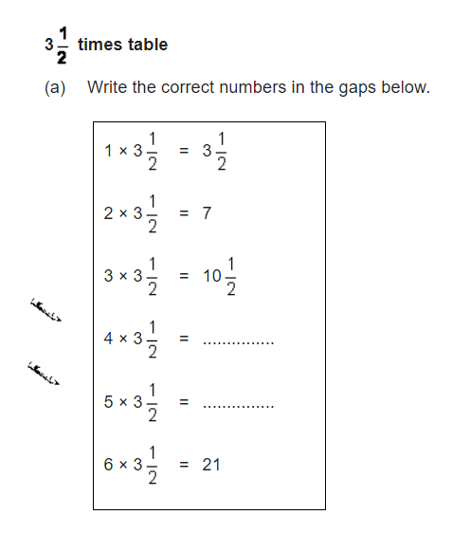
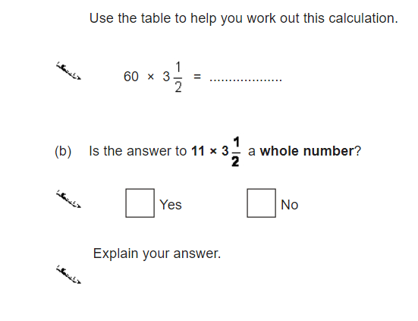
HIAS Blended Learning Resource
I know ……so…….
(Problem taken from ‘Test Base’)
0
Notes:
4 x 3$\frac{1}{2}$ = 14
5 x 3$\frac{1}{2}$ = 17$\frac{1}{2}$
60 x 3$\frac{1}{2}$ = 210
11 x 3$\frac{1}{2}$ = 38$\frac{1}{2}$ The answer will not be a while number as 11 is odd, so there are an odd number of halves (leaving one left over)

Slide 9
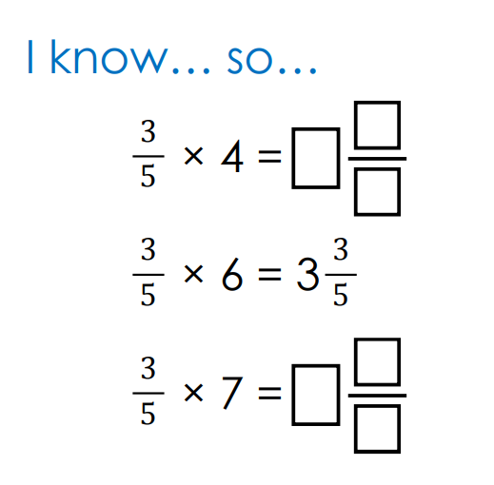
HIAS Blended Learning Resource
(Problem taken from ‘I See Reasoning’ by Gareth Metcalfe)
Notes:
$\frac{3}{5}$ x 4 = 2 $\frac{2}{5}$
$\frac{3}{5}$ x 7 = 4 $\frac{1}{5}$

Slide 10
HIAS Blended Learning Resource
(Problem taken from ‘I See Reasoning’ by Gareth Metcalfe)
Notes:
Students will make their own choices about which is the easiest and which is the hardest
They should give reasons for their choices
$\frac{1}{4}$ x 5 = $\frac{5}{4}$= 1 $\frac{1}{4}$
$\frac{3}{4}$ x 3 = $\frac{9}{4}$= 2 $\frac{1}{4}$
$\frac{3}{10}$ x 3 = $\frac{9}{10}$

Slide 11
HIAS Maths team
HIAS Blended Learning Resource
The HIAS maths team offer a wide range of high-quality services to support schools in improving outcomes for learners, including courses, bespoke consultancy and in-house training.
For further details, please contact any member of the secondary maths team:
Jo Lees: Jo.Lees@hants.gov.uk
Jenny Burn: Jenny.Burn@hants.gov.uk
Tessa Ingrey: Tessa.Ingrey@hants.gov.uk
For further details on the full range of services available please contact us using the following details:
Tel: 01962 874820 or email: hias.enquiries@hants.gov.uk
For further details on the full range of services available please contact us using the following details:
Tel: 01962 874820 or email: hias.enquiries@hants.gov.uk

